Slide 1
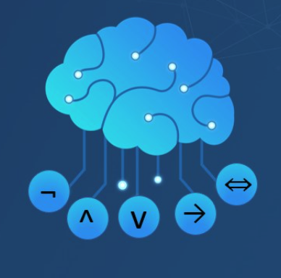
Artificial Intelligence
Propositional Logic (part 2)
CS 444 – Spring 2021
Dr. Kevin Molloy
Department of Computer Science
James Madison University
Much of this lecture is taken from
Dan Klein and Pieter Abbeel AI class at UC Berkeley

Slide 2
Proof Methods
Proof methods divide into (roughly) two kinds:
Model checking:
Truth table enumeration (always exponential in n)
Improved backtracking, e.g., Davis-Putnam-Logemann-Loveland
Backtracking with constraint propagation, backjumping
Heuristic search in model space (sound but incomplete) e.g., min-conflicts, etc.
Theorem Proving/Deductive Systems: Application of inference rules
Legitimate (sound) generation of new sentences from old
Proof = a sequence of inference rule applications
Typically requires translation of sentence into a normal form

Slide 3
Logical Equivalence
Two sentences are logically equivalent iff true in the same models.
𝛼 ≡ 𝛽 iff a ⊨ 𝛽 and 𝛽 ⊨𝛼
(𝛼 ∧ 𝛽) ≡ (𝛽 ∧ 𝛼) | Commutativity of ∧
(𝛼 ∨ 𝛽) ≡ (𝛽 ∨ 𝛼) | Commutativity of ∨
((𝛼 ∧ 𝛽) ∧ 𝛾) ≡ (𝛼 ∧ (𝛽 ∧ 𝛾)) | Associativity of ∧
((𝛼 ∨ 𝛽) ∨ 𝛾) ≡ (𝛼 ∨ (𝛽 ∨ 𝛾)) | Associativity of ∨
¬(¬𝛼) ≡ 𝛼 | Double negation elimination
(𝛼 ⟹ 𝛽) ≡ (¬𝛽 ⟹ ¬𝛼) | Contrapositive
(𝛼 ⟹ 𝛽) ≡ (¬𝛼 ∨ 𝛽) | Implication elimination
(𝛼 ⇔ 𝛽) ≡ ((𝛼 ⟹ 𝛽) ∧ (𝛽 ⟹ 𝛼)) | Biconditional elimination
¬(𝛼 ∧ 𝛽) ≡ (¬𝛼 ∨ ¬ 𝛽) | de Morgan
¬(𝛼 ∨ 𝛽) ≡ (¬𝛼 ∧ ¬𝛽) | de Morgan
(𝛼 ∧ (𝛽 ∨ 𝛾)) ≡ ((𝛼 ∧ 𝛽) ∨ (𝛼 ∧ 𝛾)) | Distribution ∧ of over ∨
(𝛼 ∨ (𝛽 ∧ 𝛾)) ≡ ((𝛼 ∨ 𝛽) ∧ (𝛼 ∨ 𝛾)) | Distribution ∨ of over ∧

Slide 4
Validity and Satisfiability
A sentence is valid if it is true in all models.
e.g., True, A ∨ ¬A, A ⟹ A, (A ∧ (A ⟹ B)) ⟹ B
Validity is connected to inference via the Deduction Theorem:
KB ⊨ 𝛼 iff (KB ⟹ 𝛼) is valid
A sentence is satisfiable if it is true in some model. e.g., A ∨ B, C
A sentence is unsatisfiable if it is true in no model. e.g., A ∧ ¬A
Satisfiability is connected to inference via the following:
KB ⊨ 𝛼 iff (KB ∧ ¬𝛼) is unsatisfiable
i.e., prove 𝛼 by reduction ad absurdum (by contradiction)

Slide 5
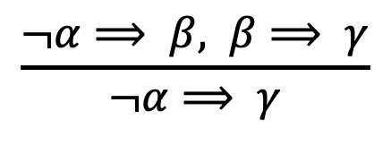
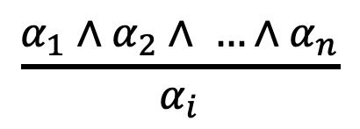
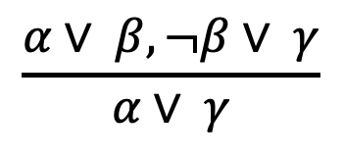
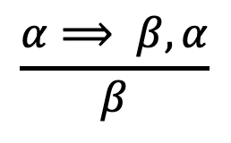
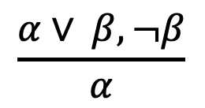
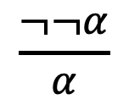
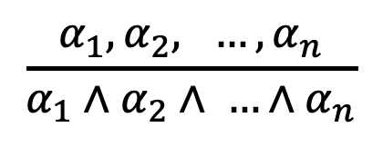
Deductive Systems: Rules of Inference
Modus ponens or implication-elimination (form an implication and the premise of the implication, you can infer the solution):
$$\frac{α⟹ β, α}{β}$$
And-elimination (from a conjunction, you can infer any of the conjuncts):
$$\frac{α_{1}∧α_{2}∧ …∧α_{n}}{α_{i}}$$
And-introduction (from a list of sentences, you can infer their conjunction)
$$\frac{α_{1}, α_{2}, …, α_{n}}{α_{1}∧α_{2}∧ …∧α_{n}}$$
Double negation elimination:
$$\frac{¬¬α}{α}$$
Unit resolution (from a disjunction, if one of the disjuncts if false, you can infer the other is true)
$$\frac{α∨ β, ¬β}{α}$$
Resolution: Since 𝛽 can not be true and false, one of the other disjuncts must be true in one of the premises.
$$\frac{α∨ β, ¬β∨ γ}{α∨ γ}$$
$$\frac{¬α⟹ β, β⟹ γ}{¬α⟹ γ}$$

Slide 6
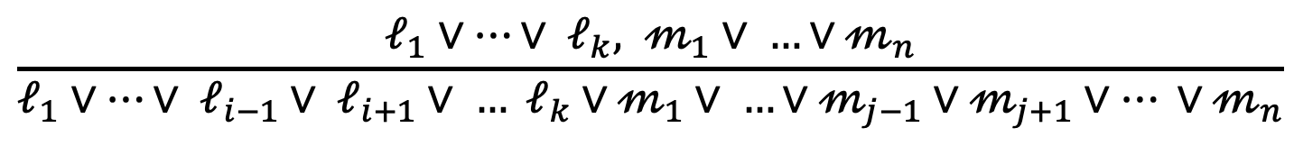
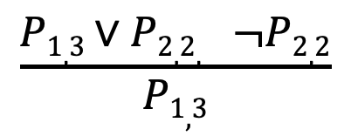
Inference by Resolution
Conjunction Normal Form (CNF – universal)
Conjunction of disjunctions of literals
e.g. (A ∨ ¬B) ∧ (B ∨ ¬C ∨ ¬D)
Resolution inference rule (for CNF): complete for propositional logic
$$\frac{ℓ_{1}∨…∨ ℓ_{k}, 𝓂_{1}∨ …∨𝓂_{n}}{ℓ_{1}∨…∨ ℓ_{i−1}∨ ℓ_{i+1}∨ … ℓ_{k}∨𝓂_{1}∨ …∨𝓂_{j−1}∨𝓂_{j+1}∨… ∨𝓂_{n}}$$
Where 𝓁_{I} and 𝓂_{j} are complementary literals. e.g.
$$\frac{P1,3∨P2,2, ¬P2,2}{P1,3}$$
Resolution is sound and complete for propositional logic

Slide 7
Conversion to CNF
B_{1,1} ⇔ (P_{1,2} ∨ P_{2,1})
1. Eliminate ⇔ replacing 𝛼 ⇔ 𝛽 with (𝛼⟹𝛽) ∧ (𝛽⟹𝛼)
(B_{1,1} ⟹ (P_{1,2} ∨ P_{2,1})) ∧ ((P_{1,2} ∨ P_{2,1})) ⟹ B_{1,1}
2. Eliminate ⟹, replacing 𝛼 ⟹ 𝛽 with ¬𝛼 ∨ 𝛽
(¬B_{1,1} ∨ P_{1,2} ∨ P_{2,1}) ∧ (¬(P_{1,2} ∨ P_{2,1}) ∨ B_{1,1})
3. Move ¬ inwards using de Morgan’s rules and double negation.
(¬B_{1,1} ∨ P_{1,2} ∨ P_{2,1}) ∧ ((¬P_{1,2} ∧ ¬P_{2,1}) ∨ B_{1,1})
4. Apply distributivity law and flatten
(¬B_{1,1} ∨ P_{1,2} ∨ P_{2,1}) ∧ (¬P_{1,2} ∨ B_{1,1}) ∧ (¬P_{2,1} ∨ B_{1,1})

Slide 8
Resolution Algorithm
function PL-Resolution(KB, 𝛼) returns true/false
Input: KB, the knowledge base, a sentence in propositional logic
𝛼, the query, a sentence in propositional logic
clauses ← the set of clauses in the CNF representation of KB ∧ ¬𝛼
new ← {}
loop do
For each C_{i}, C_{j} in clauses do
resolvents ← PL-Resolve(Ci, Cj)
if resolvents contains the empty clause then return true
new ← new U resolvents
if new ⊆ clauses then return false
clauses ← clauses U new

Slide 9
Resolution Example
KB = (B_{1,1} ⇔ (P_{1,2} ∨ P_{2,1})) ∧ ¬B_{1,1}
𝛼 = ¬P_{1,2}
Want to prove KB ^ ¬ 𝛼 is a contradiction. ((B_{1,1} ⇔ (P_{1,2} ∨ P_{2,1})) ∧ ¬B_{1,1} ∧ P_{1,2}
Step 1) Convert this clause to CNF:
(B_{1,1} ⇔∨ P_{2,1})) ∧ ¬B_{1,1} ∧ ¬P_{1,2}
(B_{1,1} ⟹ (P_{1,2} ∨ P_{2,1})) ∧ ((P_{1,2} ∨ P_{2,1}) ⟹ B_{1,1} ) ∧ ¬B_{1,1} ∧ ¬P_{1,2}
(¬B_{1,1} ∨ (P_{1,2} ∨ P_{2,1})) ∧ (¬(P_{1,2} ∨ P_{2,1}) ∨ B_{1,1} ) ∧ ¬B_{1,1} ∧ ¬P_{1,2}
(¬B_{1,1} ∨ P_{1,2} ∨ P_{2,1}) ∧ (¬(P_{1,2} ∨ P_{2,1}) ∨ B_{1,1} ) ∧ ¬B_{1,1} ∧ ¬P_{1,2}
(¬B_{1,1} ∨ P_{1,2} ∨ P_{2,1}) ∧ (¬P_{1,2} ∨ B_{1,1}) ∧ (¬P_{2,1} ∨B_{1,1}) ∧ ¬B_{1,1} ∧ ¬P_{1,2}

Slide 10
Resolution Example
(¬B_{1,1} ∨ P_{1,2} ∨ P_{2,1}) ∧ (¬P_{1,2} ∨ B_{1,1}) ∧ (¬P_{2,1} ∨B_{1,1}) ∧ ¬B_{1,1} ∧ ¬P_{1,2}
Completeness of resolution follows from the ground resolution theorem: If a set of clauses S is unsatisfiable, then the resolution closure RC(S) of those clauses contains an empty clause.
RC(S): set of all clauses derivable by repeated application of resolution rule to clauses in S or their derivatives.

Slide 11
Definite Clauses and Horn Clauses
Inference by resolution is complete, but sometimes an overkill
Definite clause: disjunction of literals of which exactly one is positive.
¬L_{1,1} ∨ B_{1,1} is a definite clause
P_{1,2} ∨ P_{1,2} is not a definite clause
Horn clause: disjunction of literals of which at most one is positive.
¬L_{1,1} ∨ B_{1,1} is a horn clause
P_{1,2} ∨ P_{1,2} is not a horn clause
Negate literals ¬A rewritten as (A ⟹ False) (integrity constraints)
Inference with Horn clauses can be done through forward chaining and backward chaining
These are more efficient than the resolution algorithm, runs in linear time

Slide 12

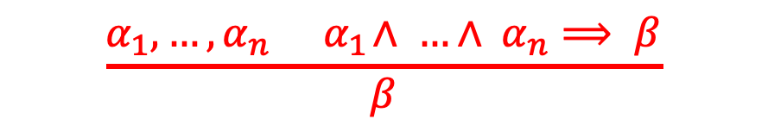
Horn Form and Forwards/Backwards Chaining
Horn Form (restricted) KB ( = conjunction of Horn clauses)
e.g., C ∧ (B ⟹ A) ∧ (C ∧ D⟹ B)
$$\frac{α_{1}, …, α_{n}{ α}_{1}∧ …∧ α_{n}⟹ β}{β}$$
Modus Ponens: complete form Horn KBs
Known as forward chaining inference rule; repeated applications until sentence of interest obtained – forward chaining algorithm.
$$\frac{¬β,{ α}_{1}∧ …∧ α_{n}⟹ β}{{ ¬(α}_{1}∧ …∧ α_{n})}$$
Modus Tollens: a form of Modus Ponens
Known as backward chaining inference rule, repeated applications until all premises obtained – backward chaining algorithm.
Both algorithms run in linear time

Slide 13
Forward Chaining
Idea: add literals in KB to facts (satisfied premises)
apply each premise satisfied in KB (fire rules)
add rule’s conclusion as new fact/premise to the KB
(this is inference propagation via forward checking).
stop when query found as fact or no more inferences.
P ⟹ Q
L ∧ M ⟹ P
B ∧ L ⟹ M
A ∧ P ⟹ L
A ∧ B ⟹ L
A
B

Slide 14
Forward Chaining Example

Slide 15
Forward Chaining Example

Slide 16
Forward Chaining Example

Slide 17
Forward Chaining Example

Slide 18
Forward Chaining Example

Slide 19
Forward Chaining Example

Slide 20
Forward Chaining Example

Slide 21
Forward Chaining – Proof of Completeness
FC derives every atomic sentence that is entailed by KB.
FC reaches a fixed point where no new atomic sentences are derived.
Consider the final state as a model m, assigning true/false to symbols
Every clause in the original KB is true in m.
Proof: Suppose a clause a₁ ∧ … ∧ a_{k} ⟹ b is false in m.
We know that a₁ ∧ … ∧ a_{k} must be true, so b must be false. But that contradicts that we have reached a fixed point. Hence:
m is a model of KB
KB ⊨ q, q is true in every mode of KB, including m

Slide 22
Backward Chaining
Idea: goal-driven reasoning – work backwards from the query q: to prove q by BC
Check if q is known already or
Prove by BC all premises of some rule concluding q
Comparing FC and BC
FC is data-driven, unconscious processing, e.g. object recognition, routine decisions.
May do LOTS of work that is irrelevant to the goal
BC is goal-driven, appropriate for problem-solving.
e.g. Where are my keys? How do I get into a PhD program?
Complexity of BC can be much less than linear in size of KB, because only relevant facts are touched.

Slide 23
Inference-based Agent in Wumpus World
A wumpus-world agent using propositional logic:
64 distinct proposition symbols, 155 sentences.

Slide 24
Propositional Logic Summary
Logical agents apply inference to a knowledge base to derive new information and make decisions.
Basic concepts of logic:
Syntax: formal structure of sentences
Semantics: truth of sentences wrt models
Entailment: necessary truth of one sentence given another
Inference: deriving sentences from other sentences
Soundness: derivations produce only entailed sentences
Completeness: derivations can produce all entailed sentences
Wumpus world requires the ability to represent partial and negated information, reason by cases, etc.
Propositional logic does not scale to environments of unbounded size, as it lacks expressive power to deal concisely with time, space, and universal patterns of relationships among objects.

